Slide 1
Bungee Candy
By: Michelle Espinosa
Hands on Activity for Middle Schoolers

Slide 2
Goals and Objectives
Goal:
Students will collect data and model their finding in a graph and compare results with others.
Objectives:
Given supplies, the students will find the distance of the cup from the floor with a certain amount of skittles in the cup
The students will then graph their findings on a scatter plot.
Students will apply their knowledge of collecting data and interpreting data information.

Slide 3
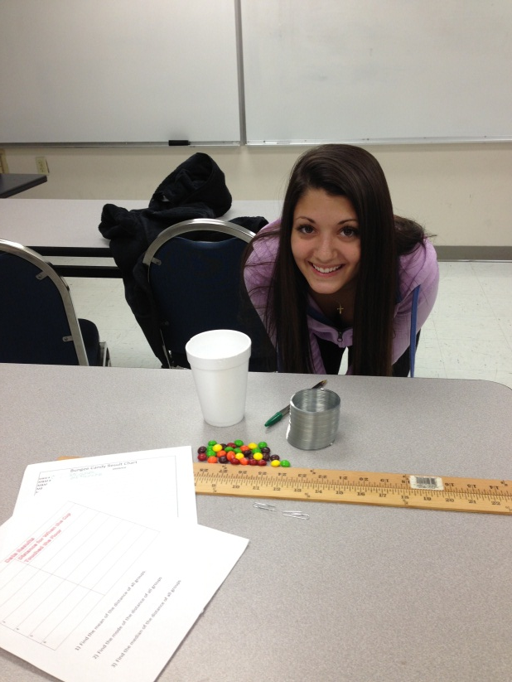
Materials
Set Up
Give students a bag of Skittles per group.
Set up classroom with meter sticks in place for the students
Have the cups with Slinkys attached
Slinky
Two yard sticks,
Two paper clips,
A paper cup
A bag of Skittles
Ruler
Worksheets

Slide 4
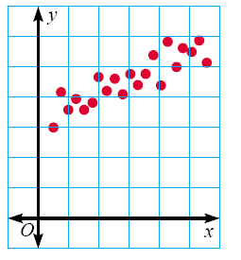
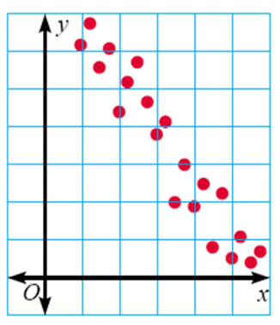
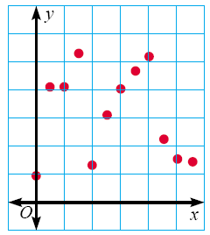
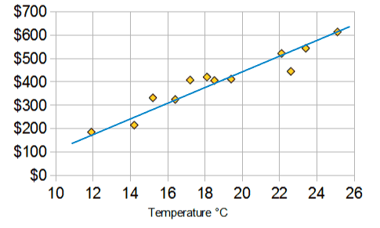
Vocabulary for Scatter Plot Graph
Positive Correlation: If the x-coordinates and the y-coordinates both increase
Negative Correlation: If the x-coordinates and the y-coordinates have one increasing and one decreasing.
No Correlation: If there seems to be no pattern, and the points looked scattered.
Trend line: A line on a graph showing the general direction that a group of points seem to be heading

Slide 5
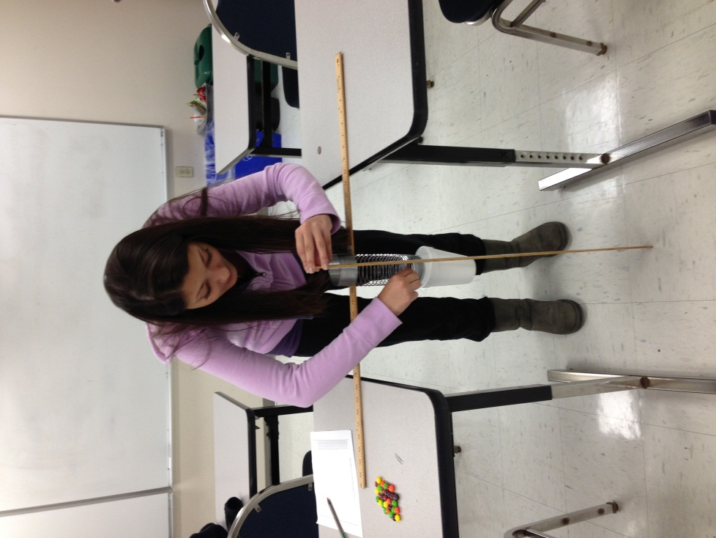
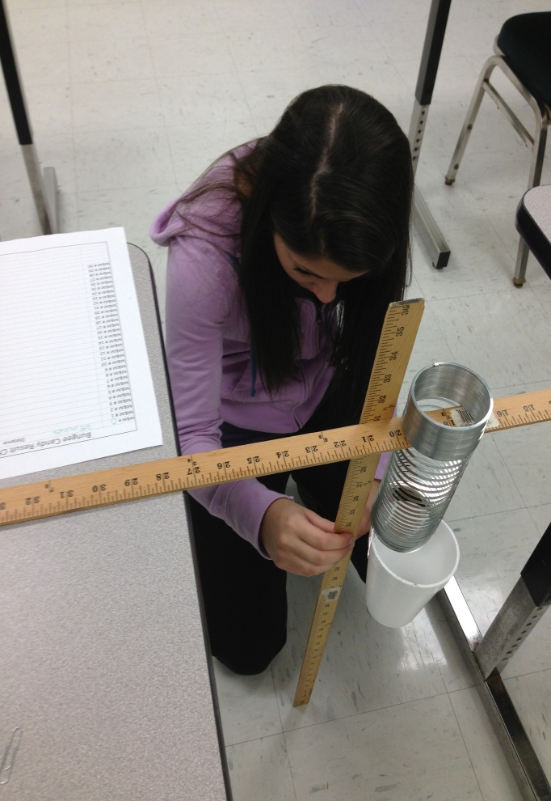
Step 1
Once the slinky stops moving. Measure the distance from the floor with the other yard stick
Students place one Skittle into the cup.

Slide 6
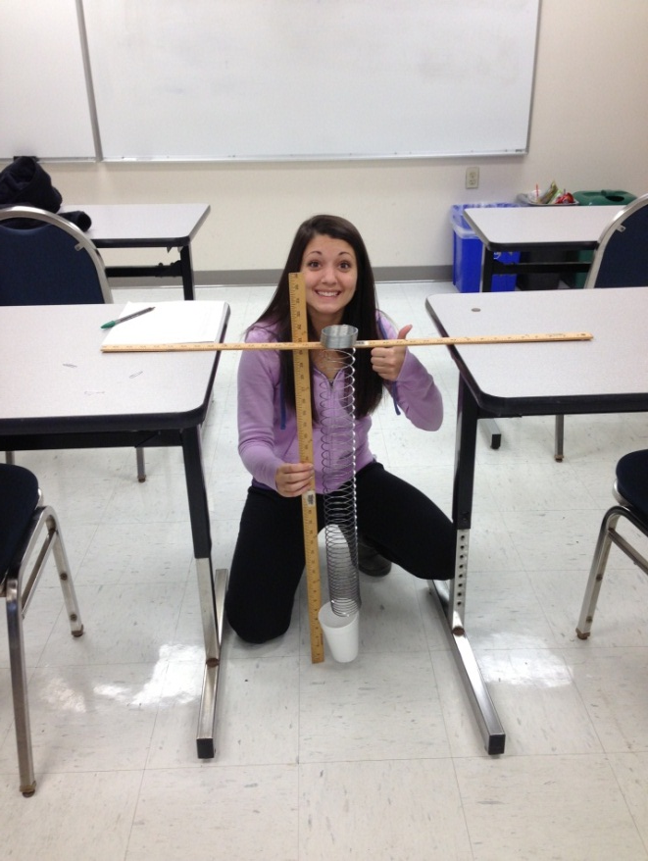
Step 2
Students keeps adding Skittles one at a time until the cup touches the floor
Students writes down the data on the Bungee Candy data result sheet.

Slide 7
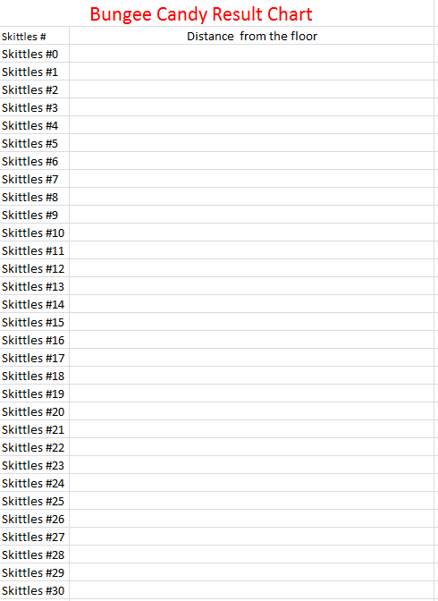
Step 3
Make a table

Slide 8
Step 4
Make a Scatter plot.

Slide 9
Step 5
Using a straight edge, make a line of “best fits”.
Determine trend line

Slide 10
Step 6
Analyzing Data
Have students write down some commonalties that they noticed while doing this experiment .
The more Skittles put in the cup, the heavier the cup gets and then touches the ground.
Students can compare data with other students in the class

Slide 11
Other Questions
Prepare a scatter plot for the following. Determine from your graph whether there is a correlation between the numbers of hours spent in a mall and the numbers of dollars spent.
Show trend lines, Determine if it’s Positive, Negative or No Correlation.

Slide 12
Connections / Adaptations
Connections
Where else would you use this application in the real world?
What are some factors that would affect this experiment ?
Adaptations
Calculus
http://danielwalsh.tumblr.com/post/11566016253/explaining-an-astonishing-slinky
Physics
http://slinky.org/

Slide 13
References
http://www.ehow.com/info_8416141_handson-secondary-math-activities.html
www.lemars.k12.ia.us/webfiles/ccollins/Prealgebra/.../Scatterplots[1].ppt

